Slide 1
Managing System on Address Book
Yupeng Song Chemistry
Peiyang Nie Chemistry
Jialin Dai Chemistry

Slide 2
CONTENTS
PART 1
Problem Statement
PART 2
Analysis
PART 3
Design
PART 4
Implementation
PART 5
Innovation
PART 6
Test

Slide 3
PART 1
Problem Statement

Slide 4
Design and implement an address book management system. Try to save address book information for multiple users in different text files. A series of operations such as adding, deleting, browsing, searching, sorting, and editing and editing related information can be performed on contacts of different users. Management of address books can be more efficient and easy.

Slide 5
PART 2
Analysis

Slide 6

In order to manage the address book, the following functions are required to be implemented:
1
Add contact
2
View all contact
Enter the system
3
Login
Find a contact
4
Delete a contact
5
Edit contacts
6
Sort

Slide 7
PART 3
Design

Slide 8
1.Add contact
2.View all contacts
Modify the password
3.Find contact
start
Login system
Open/create the corresponding file and read it
Main menu
4.Delete contact
5.Edit contact
Check the information
success
6. Sort
Don’t have corresponding account and password
Create new account
Exit
0.Exit
End

Slide 9
PART 4
Implementation

Slide 10
login
start
Get account and password
account and password
Match in
Compare information
file
Name and password are not matched
Database don’t have this account
Open/create a file based on the account
success
Create new account
“name”
N
Y
Exit
Create
enter

Slide 11
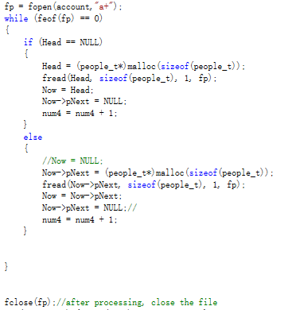
Read the file
Start
Open a file
All information got
Y
N
Head pointer ==NULL
Y
N
Head pointer point information
Add information to the linked list
Close the file

Slide 12
While flag==0
main menu
1.Add contact
Name、gender and e-mail checking( same name is illegal)
2.View all contacts
You can edit or delete a contact when you find it
3.Find contact
Main menu
Switch number
4.Delete contact
5.Edit contact
Edit corresponding information
6.Sort
Up or down according to the initial
0.Exit
flag=1
End

Slide 13
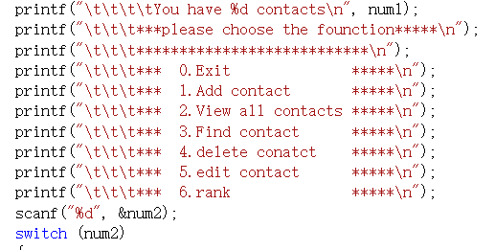
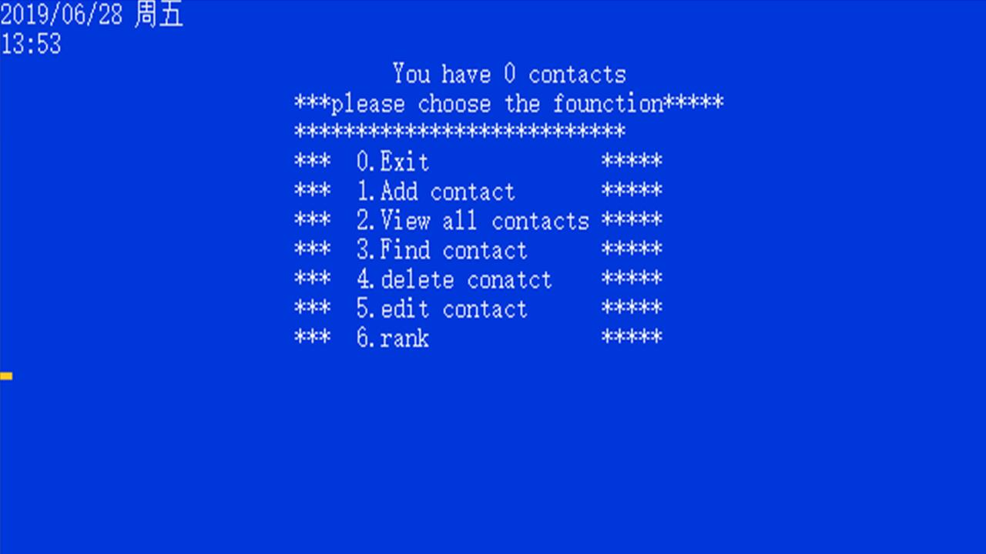

Slide 14
PART 5
Innovation

Slide 15
Check format
start
Enter a string of characters
true
Take the first element
Take the next element
Is There next element
Whether the element is @
true
Number add one
fault
true
The number is one
E-mail format is true
E-mail format is fault
fault

Slide 16
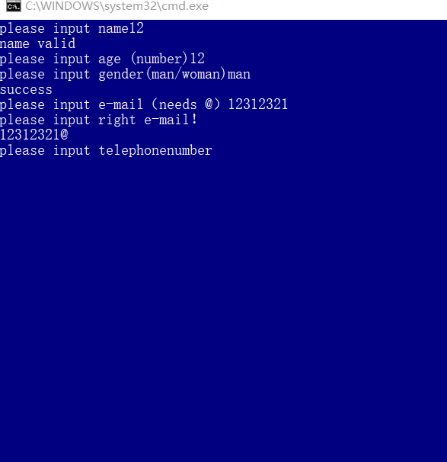

Slide 17
Password encryption
start
Get a word
Whether the word is “ ”
fault
Printf a “*”
End input
Record this word
Output all words

Slide 18
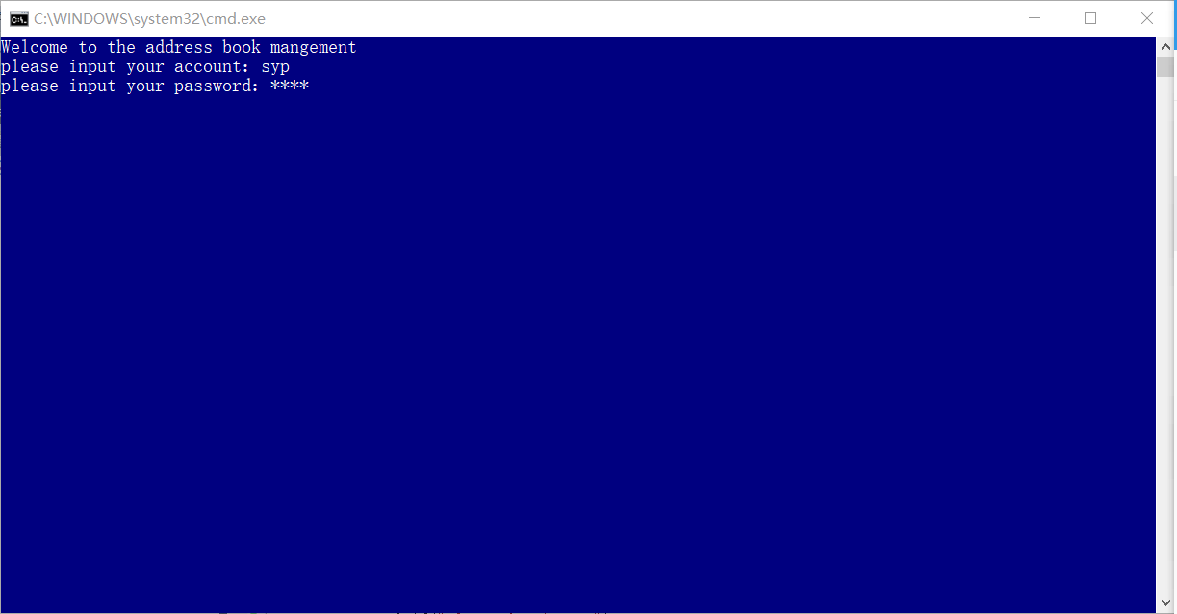
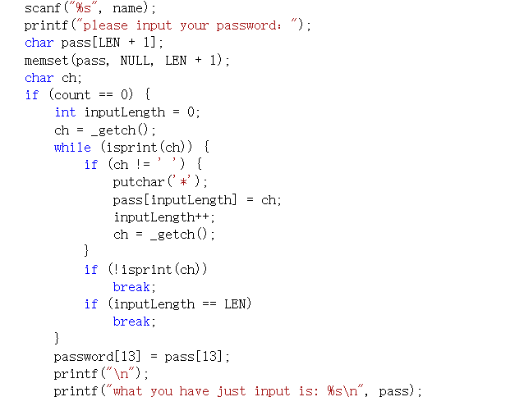

Slide 19
PART 6
Test

Slide 20
2019
THANK GUIDANCE

